Slide 1
Visual Cryptography for Gray-scale Images using AES and Bit-level. CSC 8224: Cryptography
Presenters: Rishinya Ravipati Praneetha Thotakura

Slide 2
What is Visual Cryptography?
Visual cryptography is a cryptographic technique which allows visual information to be encrypted in such a way that the decrypted information appears as a visual image.
It has many usage & application areas like Biometric security, Watermarking, Remote electronic voting, Bank customer identification etc.
Why do we need it:
In today's computer generation, data security, hiding and all such activities have become probably the most important aspect for most organizations.
These organizations spend millions of their currency to just secure their data. This urgency has risen due to increase in cyber theft/crime.
The technology has grown so much that criminals have found multiple ways to perform cyber-crime to which the concerned authorities have either less or not sufficient answer to counter.
Hence, the method of Cryptography provides the above answers. One of the most major parts of cryptography is Visual Cryptography.

Slide 3
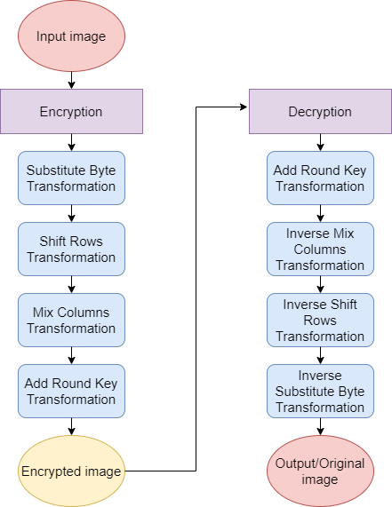
Advance Encryption Standard Algorithm (AES)
Every encryption and decryption process has two aspects: the algorithm and the key use for the encryption and decryption.
However, it is the key used for encryption and decryption that makes the process of cryptography secure.
AES algorithm mainly used for text data also for image data
As per this project an image is given as input to AES encryption algorithm which gives encrypted output.
This encrypted output is given as input to AES decryption algorithm and original image is regained as output.

Slide 4

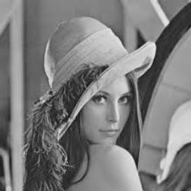
Pre-processing
In this preprocessing step, we convert a RGB image to the gray-scale image

Slide 5
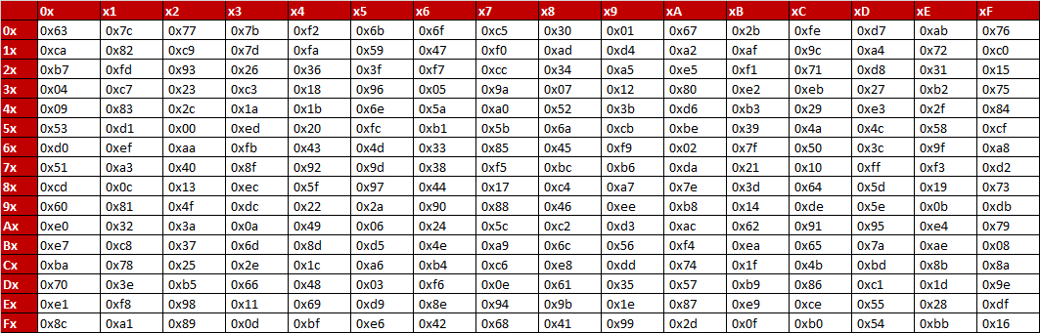
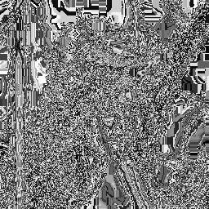
Image Encryption
Substitute byte transformation – It is a non-linear byte substitution that operates independently on each byte of the State using a substitution table S-box.

Slide 6
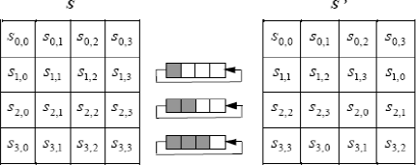
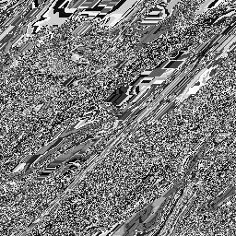
Image Encryption (cont.)
Shift rows transformation – In this concept, the bytes of rows of the State are cyclically shifted over different numbers of bytes. The first row, r=0, is not shifted. This has the effect of moving bytes to “lower” positions in the row while the “lowest” bytes wrap around into the “top” of the row.

Slide 7
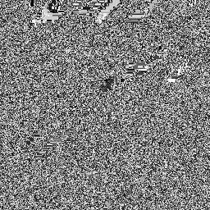
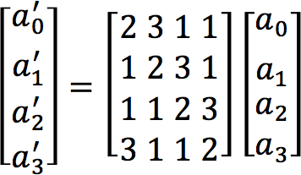
Image Encryption (cont.)
Mix columns transformation - Within this transformation, each column is taken one at a time and each byte within the column is transformed to a new value based on all four bytes in the column. For each column (a0, a1, a2 and a3) we have (where we use Galois Multiplication)

Slide 8

Image Encryption (cont.)
Add round key transformation - In the Add Round Key transformation, a Round Key is added to the State by a simple bitwise XOR operation. The Round Key is derived from the Cipher key by means of key schedule process. The State and Round Key are of the same size and to obtain the next State an XOR operation is done per element: b (i, j) = a (i, j) ⊕ k (i, j)

Slide 9
Image Decryption
Add round key transformation - The Round Key derived previously is used again. The State and Round Key are of the same size and to obtain the next State an XOR operation is done per element: b (i, j) = a (i, j) ⊕ k (i, j).

Slide 10
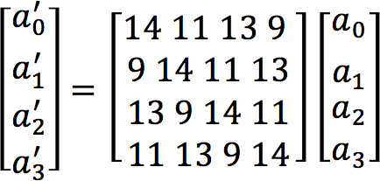
Image Decryption (cont)
Inverse Mix columns transformation - Inverse Mix Columns is the inverse of the Mix Columns transformation. The inverse is given by:

Slide 11
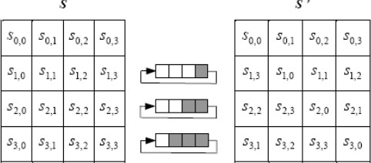
Image Decryption (cont.)
Inverse Shift rows transformation - Inverse Shift Rows is the inverse of the Shift Rows trans-formation. The bytes in the last three rows of the State are cyclically shifted over different numbers of bytes. The first row, r=0, is not shifted. The bottom three rows are cyclically shifted by Nb-shift (r, Nb) bytes, where the shift value shift (r,Nb) depends on the row number.

Slide 12
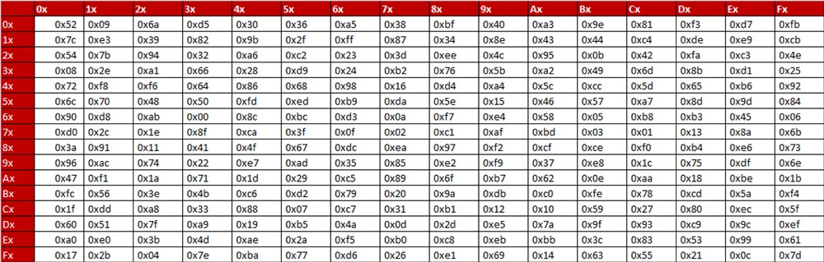
Image Decryption (cont.)
Inverse Substitute byte transformation - Inverse Substitute Bytes is the inverse of the byte substitution transformation, in which the inverse S-box is applied to each byte of the State. It is reverse process of Substitute byte transform.

Slide 13
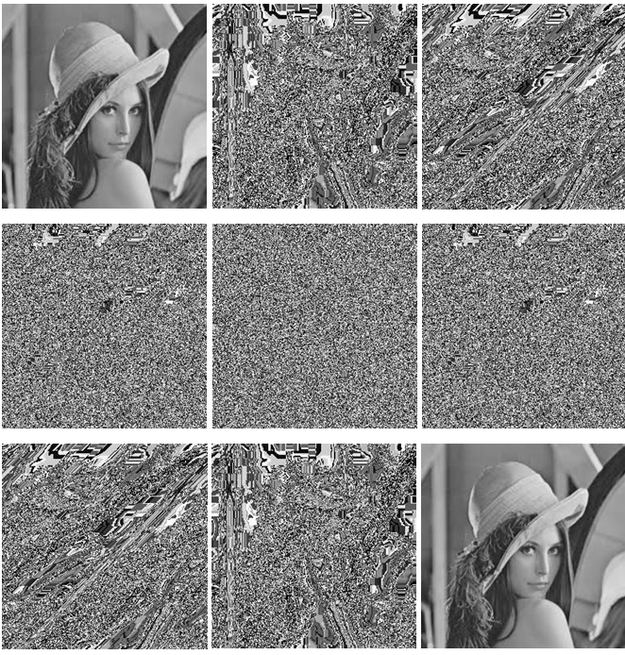
Outcome

Slide 14
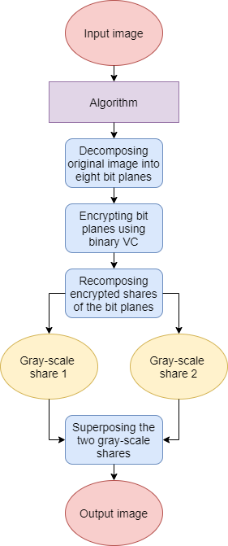
Visual Cryptography for Gray-scale Images Using Bit-level
It is an image cryptographic scheme in which a secret image is encrypted into two separate share images.
Each share individually reveals no information about the secret, but when shares are superposed the secret is revealed.
We use bit-level decomposition to extract binary bit planes from a gray scale image.
Bit level decomposition: Dividing a gray-scale image into bit planes and working on each plane separately.
Since pixel value of grayscale image lies between 0-255, its information is contained in 8 bits, so the image is divided into 8 planes.
Then the bit planes are encrypted and recomposed back as two gray-scale images.
The secret image is revealed when two gray-scale shares are superposed.

Slide 15
Working Demonstration
Blocks used in Shares and Stacking Results for Binary Images (Binary VC) :
Contrary to traditional encryption schemes, this algorithm does not have any keys.
Shares are generated based on the original image pixels values; and Human Visual System (HVS) is the decryption device.
To achieve this, encrypted images are generated block by block corresponding to each pixel in the original image.
If the pixel in original image is white, both blocks placed in encrypted images are the same and if the pixel is black, block values are inverse.
Superposing shares results in a fully black pixel block for each black pixel in the original image, and a pixel block with black subpixels for each white pixel.
Using transparency specification and HVS ability, original image is revealed if the encrypted images are superposed correctly.

Slide 16
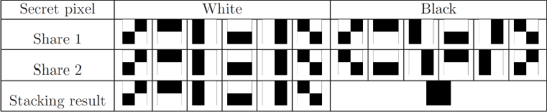
Contd…
Since there are six different blocks for each pixel in a share which are randomly chosen, decryption with a single share is impossible, taking 6^m x n states (m x n is size of the original image) for a brute force attack to decrypt the secret from a single share.
Table below illustrates an example of blocks that are used in share images.

Slide 17
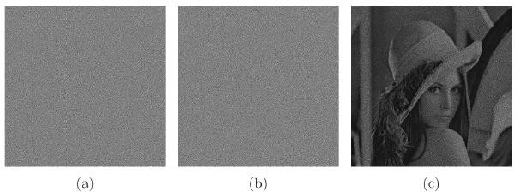
Proposed Method
To encrypt a gray-scale image into two gray-scale shares, the original image is decomposed into eight-bit planes.
Each bit plane is encrypted using binary VC (previous step).
All the encrypted shares of the bit planes are recomposed and two gray-scale shares are created.
Superposing gray-scale shares (using bitwise-AND operation) reveals the secret.

Slide 18
Conclusion for AES:
In this project, Image Encryption and Decryption using AES algorithm is implemented to secure the image data from an unauthorized access.
A Successful implementation of symmetric key AES algorithm is one of the best encryption and decryption standards available in market.
The original images can also be completely reconstructed without any distortion.
It has shown that the algorithms have extremely large security key space and can withstand most common attacks such as the brute force attack, cipher attacks and plaintext attacks.

Slide 19
Conclusion for bit level:
Visual cryptography using bit-level is a very useful technique in secure communication as it uses no computing devices in the decryption phase.
In contrast to previous methods, this method does not need the change of the original image to binary (with halftone techniques).
This makes it easy to understand and implement.
Also, decryption with a single share needs 8^2m x 2n images to find the secret with a single share.
The security of the proposed method is guaranteed because each single share leaks no information about the original image.

Slide 20
Limitations and Future Scope
AES:
The AES algorithm has no limitation as such, but there is always scope for improvement.
So, one aspect that can perhaps be pursued is to reduce the number of sub-operations in its encryption and decryption process which is currently at four each.
Bit level:
As far as the Bit-level algorithm is concerned, work can be done on it to improve its color tone and make it resemble more and more to the original image.

Slide 21


